Slide 1

NDTT1
Dye Penetrant Testing (DPT)

Slide 2
Revision/Verification Table
Rev.no | Revision Date | Revision Detail | Revised by
00 | - | - | -
Verification Table
Verified by |  | Muhammad Aamer Khan
Date |  | 20/04/2023
Notes |  | -

Slide 3


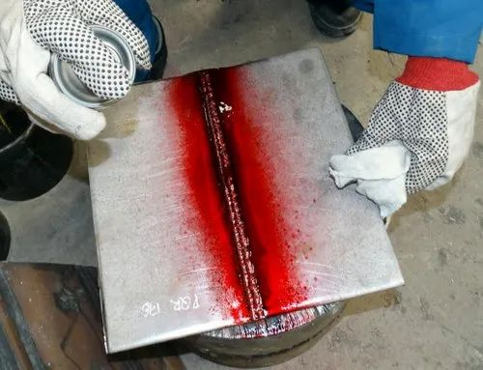
CONTENTS
Introduction
Learning Objective
Training Schedule
Examination Criteria
Main Training

Slide 4
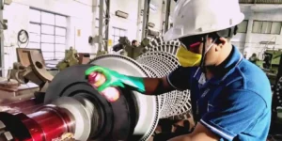
INTRODUCTION
This presentation is intended to provide knowledge of what is DPT, working principle, procedure, and application of DPT.
This is a Special Module course and is mandatory for all the Trainees of Bahria Classification Society.

Slide 5
LEARNING OBJECTIVES
The objective of this training is to establish familiarization and understanding of attendees about Dye Penetrant Testing (DPT).

Slide 6
TRAINING SCHEDULE
The training course is scheduled for 2-3 Hours
Training Starts at
0900
Break 1
1000-1015
Training Continuation
1015-1115
Break 2
1115-1130
Training Continuation
1130-1200/1230

Slide 7

EXAMINATION CRITERIA
Total Questions: 15
Total Marks: 30
Passing Marks: 18
Total Time: 30 min
Examination Date: Within 7 working days of Training

Slide 8
MAIN TRAINING

Slide 9
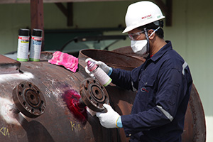
INTRODUCTION
Dye penetrant inspection (DPI) is type of NDT, also called liquid penetrate inspection (LPI) or penetrant testing (PT).
Liquid penetrant testing is a method that is used to reveal surface defects by bleed-out of a colored or fluorescent dye from the defect.
This technique is used to detect casting, forging and welding defects such as cracks, surface porosity, pinhole and blow hole etc.
It is widely applied and low-cost inspection method for all non-porous materials (metals, plastics, or ceramics).

Slide 10

HISTORY
Oil and whiting method used in the railway industry in the early 1900s was the first recognized use of the principles of penetrants to detect cracks.
The oil and whiting method used an oil solvent for cleaning followed by the application of a whiting or chalk coating, which then absorbed oil from the cracks revealing their locations.
Soon the dye was added to the liquid.
By the 1940s, dye was added to the oil used to penetrate test objects.

Slide 11
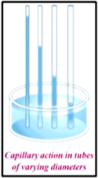
WORKING PRINCIPLE
DPT is based upon capillary action, where low surface tension fluid penetrates into clean and dry surface breaking discontinuities.
Capillary Action:
It is the ability of a liquid to flow in narrow spaces without the assistance of, or even in opposition to, external forces like gravity.
It occurs because of intermolecular forces between the liquid and surrounding solid surfaces.

Slide 12
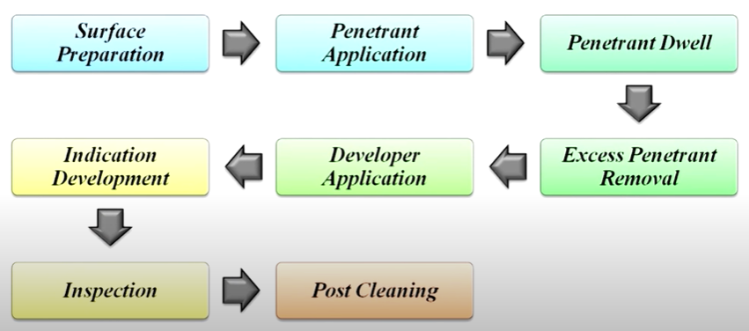
DPT PROCEDURE
Basic processing steps of DPT are as follows:

Slide 13
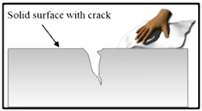
STEP-1: SURFACE PREPARATION
Most critical steps of a liquid penetrant inspection.
The surface must be free of oil, grease, water, or other contaminants that may prevent penetrant from entering into flaws.

Slide 14
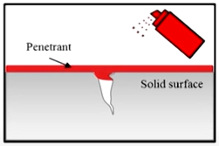
STEP-2: PENETRANT APPLICATION
Once the surface has been thoroughly cleaned and dried, the penetrant material is applied by spraying, brushing, or immersing the part in a penetrant bath.

Slide 15
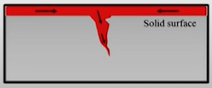
STEP-3: PENETRANT DWELL
The penetrant is left on the surface for a sufficient time to allow as much penetrant as possible to seep into a defect.
Penetrant dwell time is the total time that the penetrant is in contact with the part surface.

Slide 16
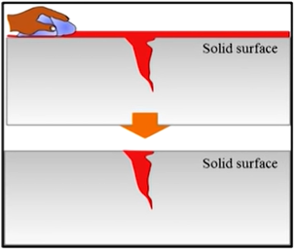
STEP-4: EXCESS PENETRANT REMOVAL
  This is the most delicate part of the inspection procedure because the excess penetrant must be removed from the surface of the sample while removing as little penetrant as possible from defects.
  Depending on the penetrant system used, this step may involve cleaning with a solvent, direct rinsing with water, or first treating the part with an emulsifier and then rinsing with water.

Slide 17
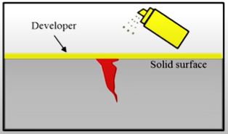
Step-5: Developer Application
  A thin layer of developer is then applied to the sample to draw penetrant trapped in flaws back to the surface where it will be visible.
  Developers come in a variety of forms that may be applied by dusting (dry powdered), dipping, or spraying (wet developers).

Slide 18
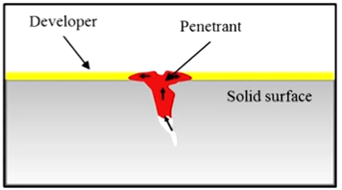
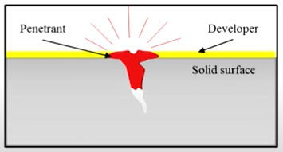
Step-6: Indication Development
The developer is allowed to stand on the part surface for a period of time sufficient to permit the extraction of the trapped penetrant out of any surface flaws.
This development time is usually a minimum of 10 minutes.

Slide 19
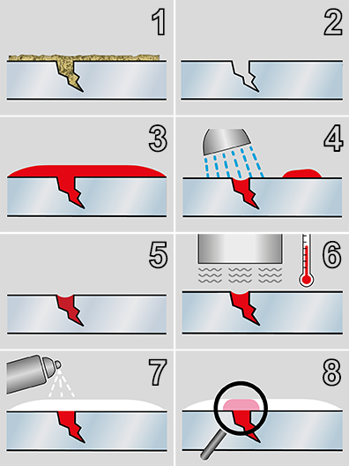
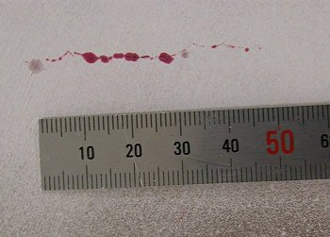
Step-7: Inspection/Evaluation
Inspection is then performed under appropriate lighting to detect indications from any flaws which may be present.
Defects are recorded.

Slide 20
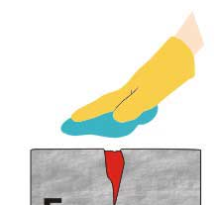
Step-8: Post Cleaning
The test surface is cleaned after inspection.

Slide 21
DPT Items
Following items are used in DPT:
Cleaner/Remover
Penetrant
Developer

Slide 22
Penetrant Materials
The penetrants are mixtures of organic solvents, which are characterized by their ability to wet materials, spread rapidly and penetrate into defects.
These materials used today are much more sophisticated than kerosene and whiting first used by railroad inspectors near the turn of 20th century.
Today's penetrants are carefully formulated to produce the level of sensitivity desired by the inspector.

Slide 23
CHARACTERISTICS OF LIQUID PENETRANTS
  To perform well, a penetrant must possess a number of important characteristics.
    It should spread easily over the surface being inspected.
    It should be easily drawn into discontinuities by capillary action.
    It should not be harmful to the inspector or the material being tested.
    It should possess high indicating capability & less dwell time.
    It should remain in fluid state.
    It should not affect the physical and chemical properties of the testing material.

Slide 24
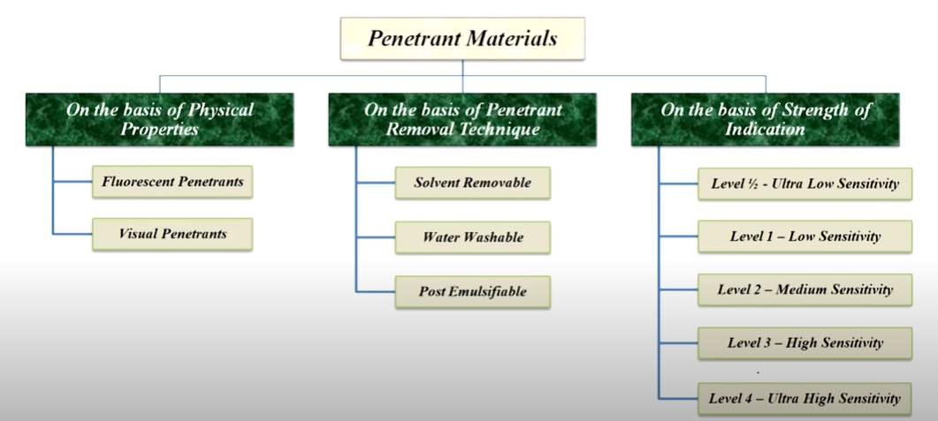
Classification of Penetrant Materials

Slide 25
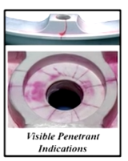
CLASSIFICATION ON THE BASIS OF THEIR PHYSICAL PROPERTIES
  On the basis of their physical properties, penetrants are classified as:
  Visible Liquid Penetrants:
    They are usually red in color and produces a contrasting indication against the white developer back ground.
    They do not require a darkened area and an ultraviolet light in order to make an inspection.
    They are also less vulnerable to contamination from things such as cleaning fluid that can significantly reduce the strength of a fluorescent indication.

Slide 26
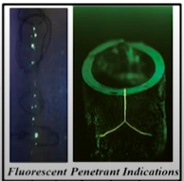
CLASSIFICATION ON THE BASIS OF THEIR PHYSICAL PROPERTIES
  Fluorescent Penetrants:
    They are generally green in color and contain dye that glows brightly when exposed to UV lights.
    These systems are more sensitive than visible penetrant systems because the eye is drawn to the glow of the fluorescing indication.
    Dual sensitivity penetrant
    this types of penetrant combines of visible penetrant and fluorescent penetrant.
    Indication can be visible under normal light also black light.

Slide 27
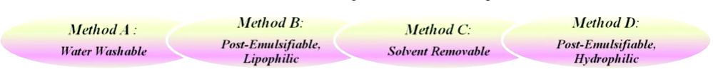
CLASSIFICATION ON THE BASIS OF REMOVAL
Each types of penetrant is again classified into 4 groups according to their removal process.
  Water Washable Penetrant
  Post Emulsifiable Penetrant - Lipophilic
  Solvent Removal Penetrant
  Post Emulsifiable Penetrant - Hydrophilic

Slide 28
CLASSIFICATION ON THE BASIS OF REMOVAL
Method A: Water Washable
  Also called as self-emulsifying systems, can be removed from part by rinsing with water alone.
  These penetrants contain an emulsifying agent (detergent) that makes it possible to wash the penetrant from the part surface with water alone.
Method B: Post Emulsifiable - Lipophilic
  In this lipophilic systems, penetrant is oil soluble and interacts with oil-based emulsifier to make removal possible.

Slide 29
CLASSIFICATION ON THE BASIS OF REMOVAL
Method C: Solvent Removable
  Solvent removable penetrants require the use of a solvent to remove the penetrant from the part.
Method D: Post Emulsifiable - Hydrophilic
  Post Emulsifiable - hydrophilic systems, used an emulsifier that is a water soluble detergent which lifts the excess penetrant from the surface of part with a water wash.

Slide 30
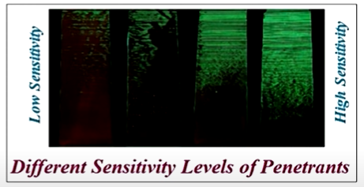
Classification of Penetrants on the basis of their Strength of Indication
Penetrants are also formulated to produce a variety of sensitivity levels.
The higher the sensitivity level, the smaller the defect that the penetrant system is capable of detecting.
The five sensitivity levels are:
  Level - Ultra Low Sensitivity
  Level 1 - Low Sensitivity
  Level 2 - Medium Sensitivity
  Level 3 - High Sensitivity
  Level 4 - Ultra-High Sensitivity

Slide 31
Classification of Penetrants on the basis of their Strength of Indication
As the sensitivity level increases, so does the number of non-relevant indications.
Therefore, a penetrant needs to be selected that will find the defects of interest but not produce too many non-relevant indications.

Slide 32
Developer
  It's role is to pull the trapped penetrant material out of defects and spread it out on the surface of the part so it can be seen by an inspector.
  Developers also create a white background so there is a greater degree of contrast between the indication and the surrounding background.
Characteristics of Good Developer
  It should have good absorption characteristics.
  It should be chemically inert with test material.
  It should be able to uniformly cover the surface with thin smooth coating.
  It should provide a good contrast background for bright and clean indications
  It should be non-toxic.
  It should be easy to remove after inspection.

Slide 33
Classification of Developers
  Developer classification is based on the method that the developer is applied.
  There are four forms of developers in general use:
    Water Soluble Developers
    Dry Powder Developers
    Water Suspendable Developers
    Non-aqueous Developers

Slide 34
Water Soluble Developers
  They consist of a group of chemicals that are dissolved in water and form a developer layer when the water is evaporated away.
  The best method for applying water soluble developers is by spraying it on the part.
  Dipping, or brushing the solution on to the surface is sometimes used but these methods are less desirable.

Slide 35
Dry Powder Developer
Dry powder developer is generally considered to be the least sensitive but it is inexpensive to use and easy to apply.
Dry developers are white, fluffy powder that can be applied to a thoroughly dry surface in a number of ways:
  Dipping parts in a container of developer.
  Using puffer to dust parts with developer.
  Using electrostatic powder spray guns.
  Placing part in a dust cabinet where developer is blown around and allowed to settle on the part.

Slide 36
Dry Powder Developer
Advantage:
  When a dry developer is used, indications tend to stay bright and sharp since the penetrant has a limited amount of room to spread.
Limitation:
  Since dry powder developers only stick to the area where penetrant is present, the dry developer does not provide a uniform white background as the other forms of developers do.

Slide 37
Water Suspendable Developers
Water suspendable developers consist of insoluble developer particles suspended in water.
Water suspendable developers require frequent stirring or agitation to keep the particles from settling out of suspension.
Water suspendable developers are applied to parts in the same manner as water soluble developers.
Parts coated with a water suspendable developer must be forced dried just as parts coated with a water soluble developers are forced dried.

Slide 38
Non-aqueous Developers
Non-aqueous developers suspend the developer in a volatile solvent and are typically applied with a spray gun.
Non-aqueous developers are commonly distributed in aerosol spray cans for portability.
Since the solvent is highly volatile, forced drying is not required.

Slide 39
Common Uses of Dye Penetrant Testing
Materials that are commonly inspected using DPT include the following:
  Metals (aluminum, copper, steel, titanium, etc.)
  Glass
  Many ceramic materials
  Rubber
  Plastics

Slide 40
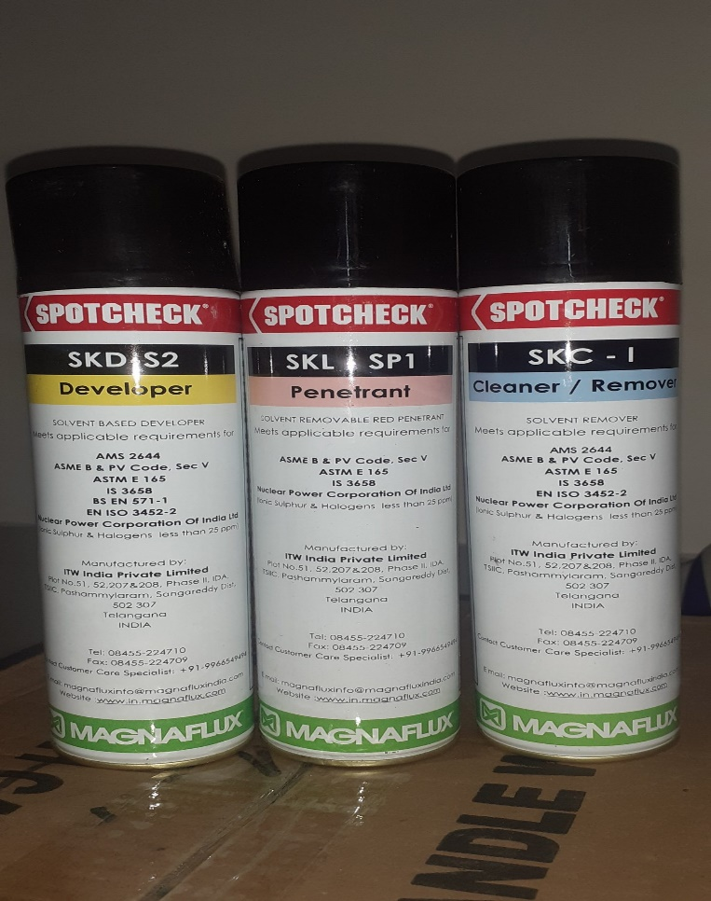
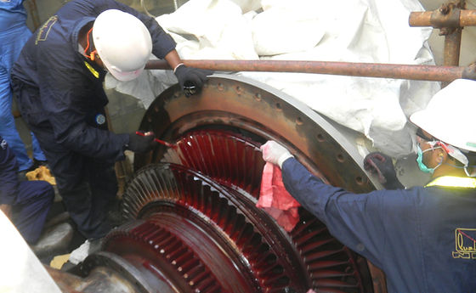
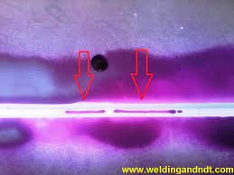
ADVANTAGES
Sensitive to small surface discontinuities
Can inspect metal and non-metal
Works on complex geometric shapes
Portable
Affordable
Its relatively easy to use

Slide 41
LIMITATIONS
Only sensitive to surface-breaking defects.
Surface must be clean properly.
Can not inspect porous metal generally.
No depth sizing.
Some rubber and plastics may be affected by penetrant material

Slide 42
Safety Precautions
  When proper health and safety precautions are followed, liquid penetrant inspection operations can be completed without any harm to inspection personnel.
  Some of the most common safety concerns are:
    Review material safety datasheet.
    Proper ventilation in confined spaces
    PPE’s should be worn to protect against skin irritation
    To protect injury to eyes, do not look directly inro UV light.
    Ignition sources to be avoided

Slide 43
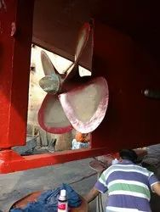
Summary
  Dye penetrant inspection is the one of the most widely used low cost inspection method.
  It can be used to locate all kinds of surface breaking flaws in all non-porous materials (metals, plastics, or ceramics).
  Penetrants are classified on the basis of their physical properties, removal techniques, and their strength of indication.
  Developers are classified on the basis of the method of their application.
  Proper health and safety precautions must be followed while performing this test.

Slide 44
Reference Links
https://www.youtube.com/watch?v=DysflzHNy4Y&list=PLN_g_HrGTvQ0284U-3o8ugL98f8v6uE0-&index=8
https://www.youtube.com/watch?v=8I1onrUqjDA&ab_channel=NDTChannel
https://www.youtube.com/watch?v=8I1onrUqjDA
https://www.youtube.com/watch?v=1cl2ULh0_ss
https://www.youtube.com/watch?v=mIXIcR59dRE
https://www.youtube.com/watch?v=E8ebW1aNTyw

Slide 45
  Thank You

